Slide 1
Spring IoC container basics
Course “Spring – first touch”
Section 3

Slide 2
Agenda
Spring IoC container
How it works?
Main interfaces
Container instantiation
Spring Beans
Dependency Injection
Bean scopes

Slide 3
Three problems
Application size
Integration
Configuration

Slide 4
Addressed problem
Application size
Integration
Configuration

Slide 5
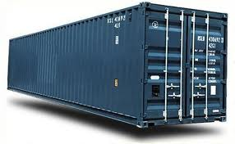
What it is?
Inversion of Control container
=
Spring Framework

Slide 6

How it work?

Slide 7
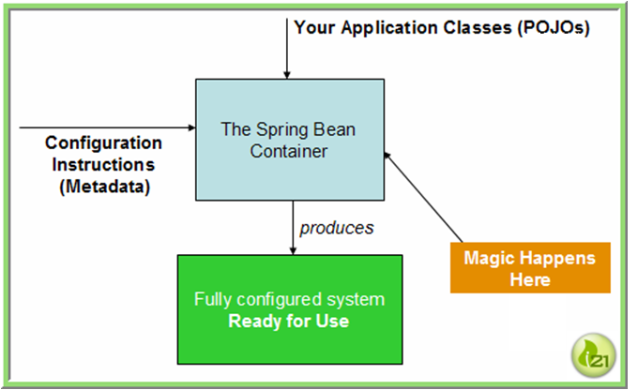
High-level view of how Spring works

Slide 8

Plain Old Java Object

Slide 9
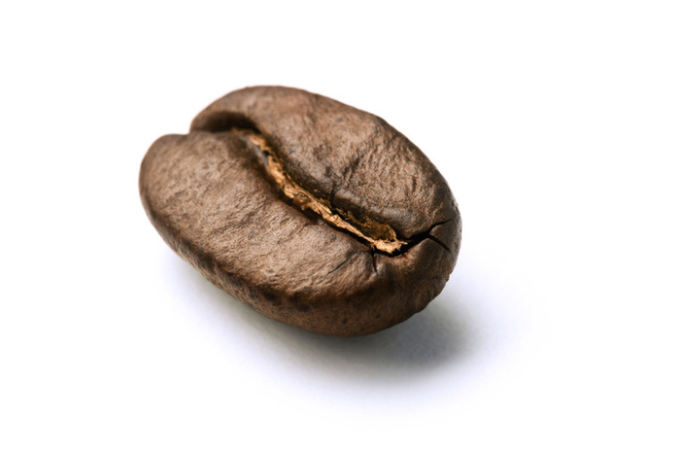
Bean

Slide 10
Container configuration
<?xml version="1.0" encoding="UTF-8"?>
<beans ... >
<bean id="myBean" class="lv.MyBean" />
<bean id="another" class="lv.AnotherBean" />
<!-- more bean definitions go here -->
</beans>

Slide 11
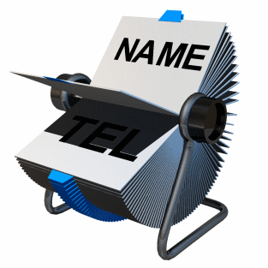
Bean ID or name
Bean ID from configuration file
Bean class name

Slide 12
Composing configuration metadata
<?xml version="1.0" encoding="UTF-8"?>
<beans ... >
<import resource="services.xml"/>
<import resource=“dao.xml"/>
<bean id="myBean" class="lv.MyBean" />
<bean id="another" class="lv.AnotherBean" />
<!-- more bean definitions go here -->
</beans>

Slide 13
Using the container
Place config XML in classpath.
From code call:
// create and configure beans
ApplicationContext context =
new ClassPathXmlApplicationContext(new String[] {"services.xml"});
// retrieve configured instance
MyBean bean = context.getBean("myBean");
// use configured instance
String userName = bean.getUsername();

Slide 14
Instantiating a Container (1)
From file system:
Resource resource =
new FileSystemResource("beans.xml");
BeanFactory factory =
new XmlBeanFactory(resource);

Slide 15
Instantiating a Container (2)
From classpath:
ClassPathResource resource =
new ClassPathResource("beans.xml");
BeanFactory factory =
new XmlBeanFactory(resource);

Slide 16
Instantiating a Container (3)
From classpath (ApplicationContext):
ApplicationContext context =
new ClassPathXmlApplicationContext
("applicationContext.xml");

Slide 17
BeanFactory interface
Provide the configuration framework basics
Define basic IoC container functionality

Slide 18
BeanFactory main methods
  boolean containsBean(String): returns true if the BeanFactory contains a bean definition or bean instance that matches the given name.
  Object getBean(String): returns an instance of the bean registered under the given name.

Slide 19
ApplicationContext interface
Is a sub-interface of BeanFactory
Adds integration with Spring's AOP features
Message resource handling
Adds more enterprise-specific functionality

Slide 20
Bean examples
DAO
DataSource
Transaction Manager
Persistence Managers
Business Components
Integration Components
etc.

Slide 21
Bean definition overview
<?xml version="1.0" encoding="UTF-8"?>
<beans ... >
<bean id="myBean" class="lv.MyBean" />
<bean id="clientService"
class="examples.ClientService"
factory-method="createInstance"/>
<!– Other definitions … -->
</beans>

Slide 22
Bean definition details
Each bean definition consists of the following set of properties:
  class
  name
  scope
  constructor arguments
  properties
  autowiring mode
  dependency checking mode
  lazy-initialization mode
  initialization method
  destruction method
Beans are created using
the instructions defined
in the configuration
metadata that has been
supplied to the container

Slide 23
Config files and code difference
Configuration files contains bean definition based on implementation classes.
Application code depends to interfaces.

Slide 24
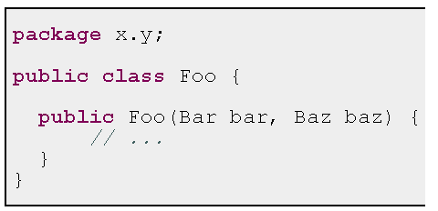
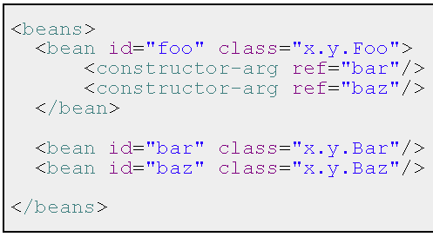
Constructor Dependency Injection

Slide 25
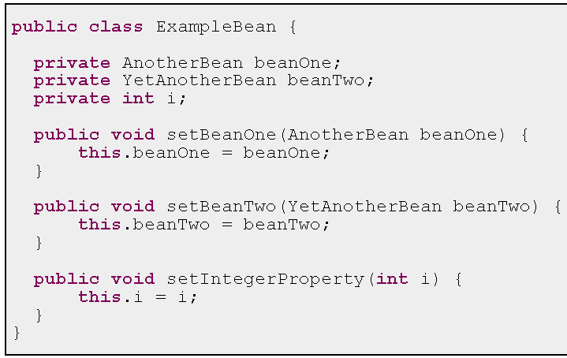
Setter Dependency Injection (1)

Slide 26
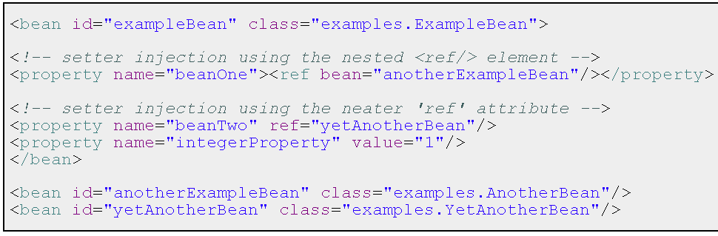
Setter Dependency Injection (2)

Slide 27
Bean scopes
Singleton scope
Prototype scope

Slide 28
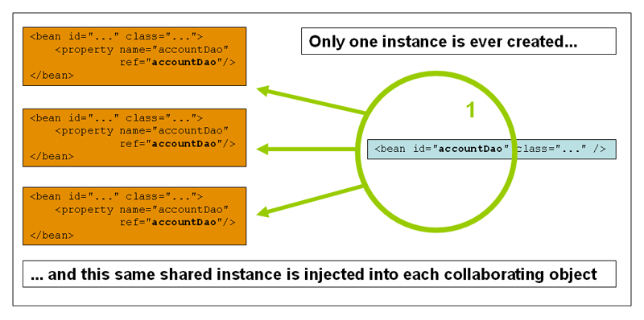
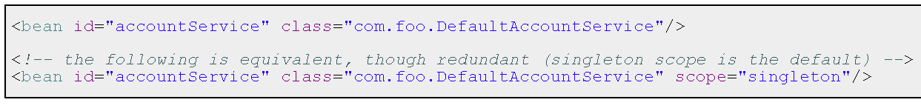
The singleton scope

Slide 29
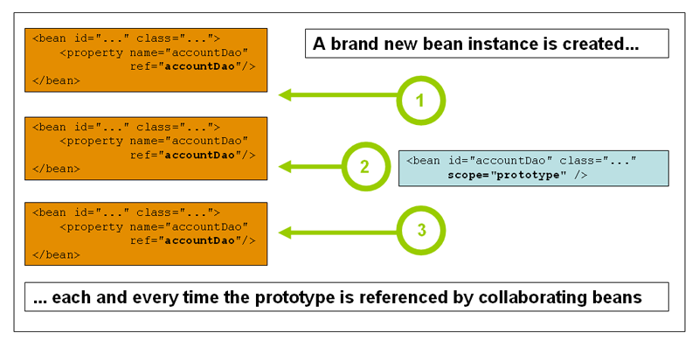
The prototype scope

Slide 30
Spring Beans and concurrency
Beans must be stateless!

Slide 31

Any Questions?

Slide 32
References
Spring Home:
http://www.springframework.org
Inversion of Control Containers and the Dependency Injection pattern http://www.martinfowler.com/articles/injection.html
Introduction to the Spring Framework by Rod Johnson
http://www.theserverside.com/tt/articles/article.tss?l=SpringFramework

Slide 33

Practice 2 and 3

